Slide 1

Trust Region Policy Optimization
Nicola Pitzalis
Intelligent System for Patter Recognition

Slide 2


Introduction to the problem
In this paper, Schulman et al. extended the work of Kakade & Langford (2002) to obtain an algorithm able to optimize large nonlinear policies such as neural networks.
discounted visitation frequencies
We want to minimize the expected discounted cost of the new policy$η(\tilde{π})$:
new policy
advantage function
But unfortunately, the complex dependencies between the new policy and the visitation frequencies make the equation hard to be optimize. Instead, a local approximation will be used:
old discounted visitation frequencies
If we use a parametrized policy $π_{θ}$ then $L_{π}$ matches $η$ to first order and hence, for a small enough step, improving $L_{π}$ also improves $η$.
Kakade & Langford proved that, for a mixture policy, the following bound holds:
maximum expected advantage
discount factor
blending parameter of the mixture policy
mixture policy

Slide 3

Constrained problem reformulation
The main theoretical result of the paper is the improvement of the bound proposed by Kakade & Langford. Specifically, Schulman et al. proved that the bound can be extended to general stochastic policies, rather than mixture of policies (hardly used in practice).
maximum KL-divergence between the two stochastic policies
follows directly from the previous bound
Then it follows, that minimizing the equation above, consequently minimizes the expected discounted cost of the new policy. We then must solve the unconstrained problem . In practice, though, the constanc $C$ is very small, resulting in trivial optimization steps.
The authors proposed the optimization of an equivalent constrained problem, where the constraint is the trust region constraint:
KEY IDEA
trust region constraint
average KL-divergence

Slide 4

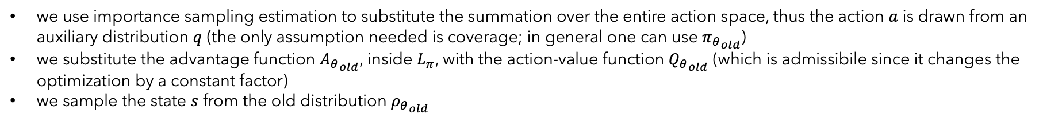
Sample-Based Estimation
The problem reformulation permits us to use Monte Carlo simulation to approximate both the objective and the constraint.
After some minor mathematical manipulations, we end up with the following problem:
we use importance sampling estimation to substitute the summation over the entire action space, thus the action $a$ is drawn from an auxiliary distribution $q$ (the only assumption needed is coverage; in general one can use ${π_{θ}}_{old}$)
we substitute the advantage function ${A_{θ}}_{old}$, inside $L_{π}$, with the action-value function ${Q_{θ}}_{old}$ (which is admissibile since it changes the optimization by a constant factor)
we sample the state $s$ from the old distribution ${ρ_{θ}}_{old}$

Slide 5
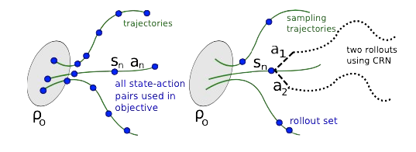
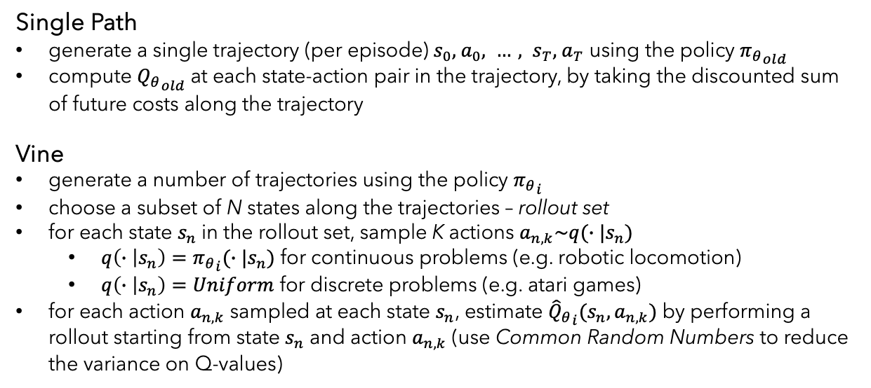
Proposed methodologies
Single Path
generate a single trajectory (per episode)${ s}_{0},{ a}_{0}, …, s_{T},{ a}_{T}$ using the policy ${π_{θ}}_{old}$
compute ${Q_{θ}}_{old}$at each state-action pair in the trajectory, by taking the discounted sum of future costs along the trajectory
Vine
generate a number of trajectories using the policy ${π_{θ}}_{i}$
choose a subset of N states along the trajectories – rollout set
for each state $s_{n}$in the rollout set, sample K actions $a_{n,k}\sim q(∙|s_{n})$
$q\left(∙ | s_{n}\right)={π_{θ}}_{i}(∙|s_{n})$ for continuous problems (e.g. robotic locomotion)
$q\left(∙ | s_{n}\right)=Uniform$ for discrete problems (e.g. atari games)
for each action $a_{n,k}$ sampled at each state $s_{n}$, estimate ${{\hat{Q}}_{θ}}_{i}(s_{n},a_{n,k})$ by performing a rollout starting from state $s_{n}$ and action $a_{n,k}$ (use Common Random Numbers to reduce the variance on Q-values)
single path
vine
After collecting the Q-values, average over samples and solve the constrained optimization problem to update the policy’s parameters.

Slide 6
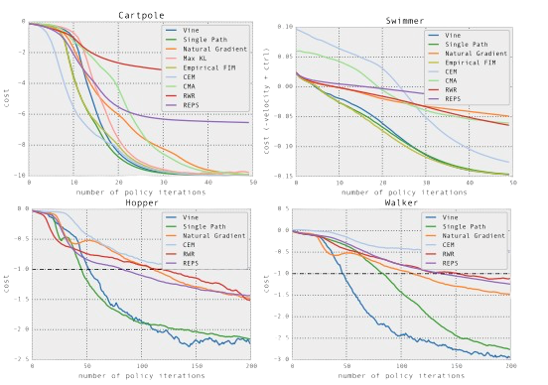
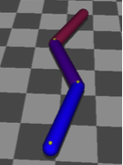
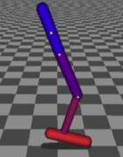
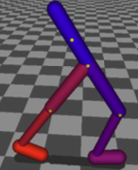
Experiments (Simulated Robotic Locomotion)
Experiments comprised carpole balancing (as a standard baseline), swimmer, hopper and walker.
swimmer
hopper
walker
The learning curves on the right show the cost averaged across five runs of each algorithm. Single path and vine TRPO solved the tasks yelding the best results between the compared algorithms.
TRPO learned with general purpose policies and simple cost functions, using minimal prior knowledge (in contrast to typical locomotion learning).

Slide 7
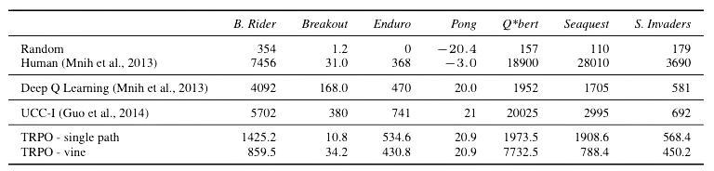
Experiments (Atari games from images)
Here, the authors trained policies for playing Atari games, using raw images as input.
Some challenges arise from the task at hand:
the games require learning different behaviours
delayed rewards
some games require complex sequence of actions
non-stationary image statistics
TRPO performed better than some of the other algorithms to which it has been compared and, in general, achieved reasonable results.

Slide 8
Conclusion
The authors provided strong theoretical foundations that not only serve as pillars for the proposed algorithms but also unify policy gradient and policy iteration methods, showing them to be special limiting cases of an algorithm that optimizes a certain objective subject to a trust region.
Some brightful ideas:
transforming the unconstrained formulation into a constrained problem
exploiting the trust region constraint over the first order approximation
exploting Monte-Carlo estimation to solve a complex optimization problem
Some weaknesses:
the single path algorithm yields high variance results
the vine algorithm lowers the variance but it is way more computationally expensive (given the MC simulations it must perform)
Strong points:
sound theoretical fundation
strong empirical results: the algorithm is able to learn very complex policies (such as the CNN used for the Atari game and the controller for the simulated robotic locomotion) using generic policy search method and non-engineered policy representations.

